Slide 1




Manifesting Change:
co-creating ethical approaches
to filmmaking practices
chuck blue lowry
action research project

Slide 2

research question
How can
collective manifesto making
support students to reflect on their positionality and develop more ethical, caring approaches to
collaborative filmmaking?

Slide 3

background
This project is a direct response to an incident in 2024 during a collaborative film project with students from LCDS, when a MA Performance: Screen student made a discriminatory comment regarding a dancer's hair while discussing makeup and costume.
This incident highlighted an urgent need to:
- challenge implicit biases
- disrupt hegemonic aesthetics in screen-based work
- embed inclusivity in creative practices
I believe there needs to be a more embedded culture of care and accountability within higher education.
Positionality
Artist, filmmaker and lecturer in MA Performance: Screen at Central Saint Martins.
- Participatory and social practice
Lecturer at CSM for 5 years.
Known the 1st year MA students for 3 months.
Elements of my identity which directly impact this research:
my artistic practice
my position within the university
being a white cis-gendered woman
being dual heritage
living with a chronic health condition

Slide 4
Key References
all flourishing is mutual
- Robin Wall Kimmerer
SEA (Socially Engaged art) depends on actual –
not imagined or hypothetical - social action
- Pablo Helguera
”non-indifference to the other” is the founding moment of selfhood
- Michael Renov
I can 100 percent promise that you learning
sign language is easier than
a deaf person learning to hear.
- Christine Sun Kim referencing Sara Nović.
what is the hardest for some, does not even exist for others.
- Sara Ahmed

Slide 5
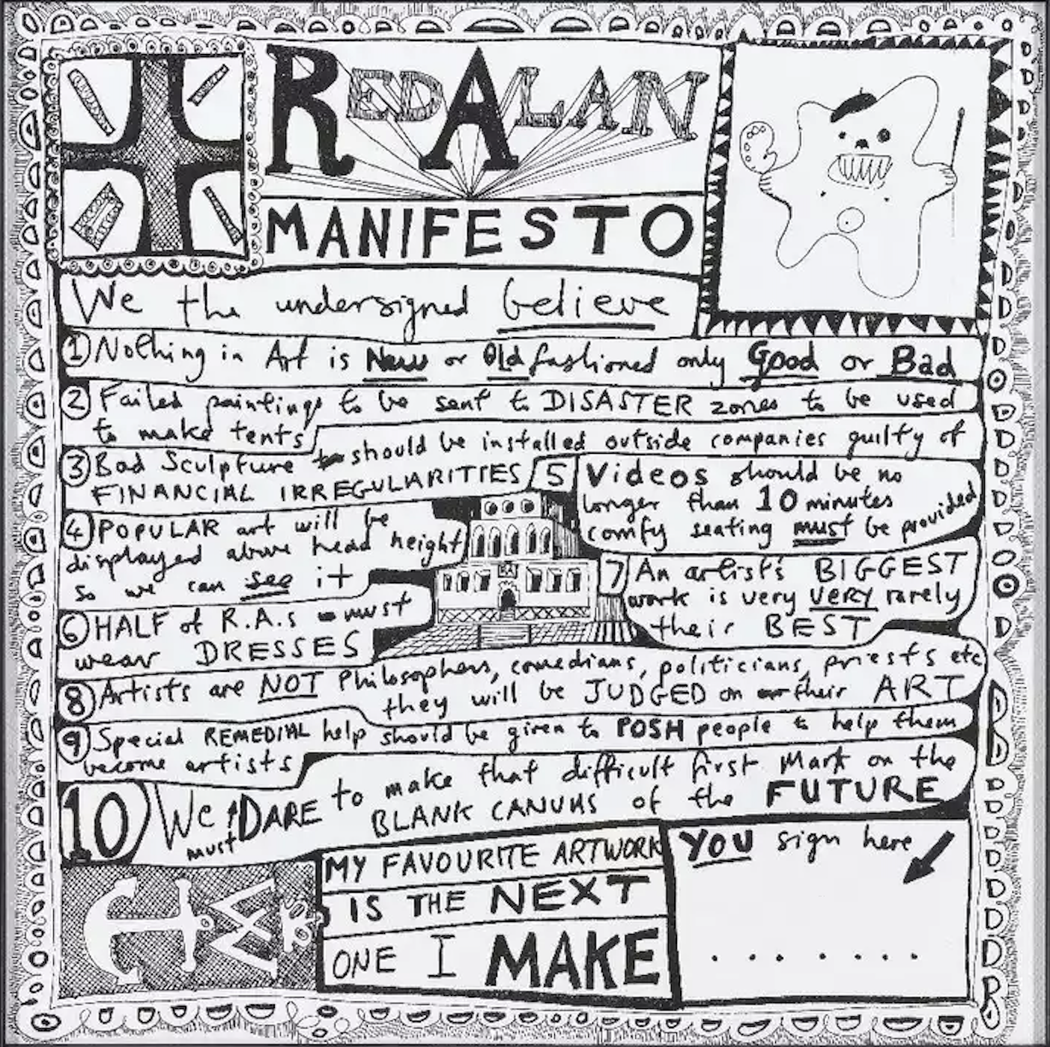
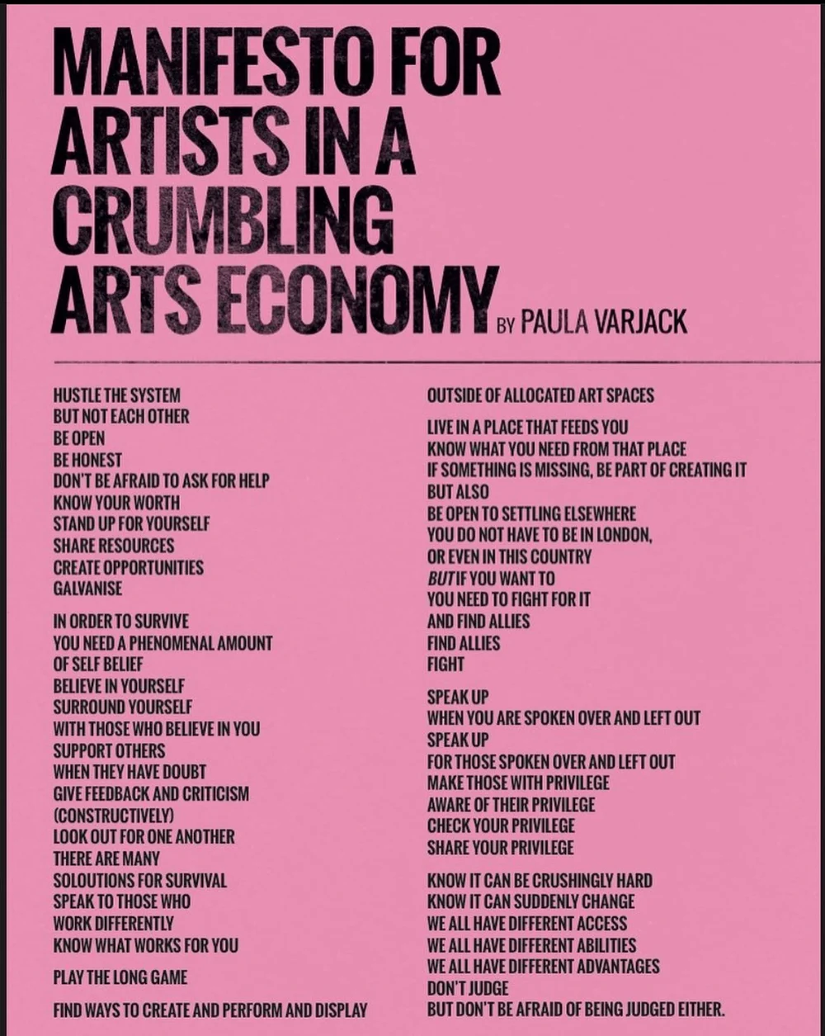
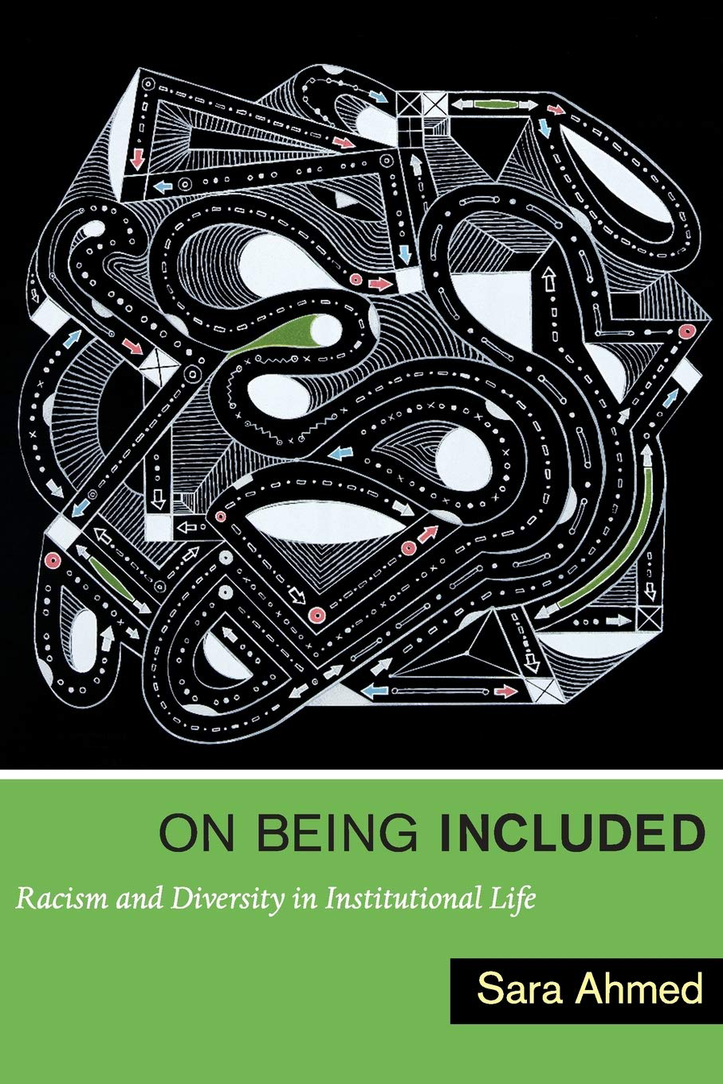
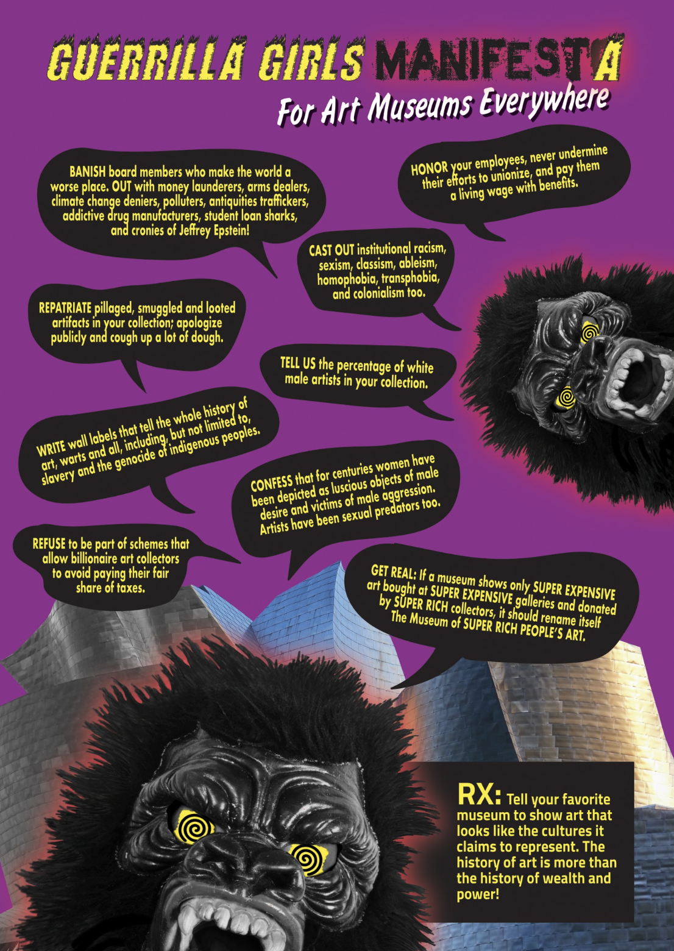
Rationale
Need for a more inclusive filmmaking culture on MA Performance: Screen.
Need for a culture of care, anti-racism, and accountability in HE.
Embedding critical reflection and ethical practices.
- Manifesto-making as a reflective tool that confronts exclusionary norms.
- Supports critical thinking and reflexivity on social and ethical issues.
Notes:
The aim of the research is to develop a more inclusive filmmaking culture on the MA Performance: Screen course, where critical reflection and ethical practices are integrated into the creative process.
This project aligns with broader institutional goals of anti-racism and ethical collaboration, and it offers a replicable model for inclusion in creative education.
It responds directly to the specifics of the course that I teach on, aiming to provide support not just in external collaborations but also internal ones between a diverse student cohort.
The intervention involves testing a creative manifesto workshop that encourages students to reflect on their positionality, values, and collective responsibilities in screen-based performance work.
The impact of this intervention will be measured directly after the manifesto workshop, and then again at the end of a 3 week collaborative project, to begin an iterative research cycle grounded in dialogue and responsiveness to qualitative and quantitative data collected from the participants.

Slide 6
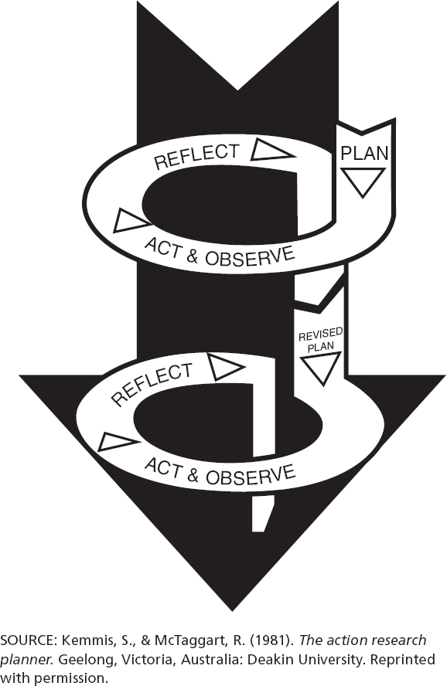
Research Methods
Participatory Action Research
Qualitative and Quantitative
Arts based
Interview with course leader
Questionnaires (Likert and Open Question)
Participatory workshops
Collective Manifesto Making and Editing
Focus Groups
Collective group selections of data
Notes:
The aim of the research is to develop a more inclusive filmmaking culture on the MA Performance: Screen course, where critical reflection and ethical practices are integrated into the creative process.
This project aligns with broader institutional goals of anti-racism and ethical collaboration, and it offers a replicable model for inclusion in creative education.
It responds directly to the specifics of the course that I teach on, aiming to provide support not just in external collaborations but also internal ones between a diverse student cohort.
The intervention involves testing a creative manifesto workshop that encourages students to reflect on their positionality, values, and collective responsibilities in screen-based performance work.
The impact of this intervention will be measured directly after the manifesto workshop, and then again at the end of a 3 week collaborative project, to begin an iterative research cycle grounded in dialogue and responsiveness to qualitative and quantitative data collected from the participants.

Slide 7
Research Methods
Ethical Considerations:
Power Dynamics
Informed Participation
Participant Wellbeing
Ownership and Representation
Confidentiality and Anonymity
Researcher Positionality
Participatory Action Research is
A viable, yet messy, Methodology
for social justice research
- Caroline Lenette
Notes:
The aim of the research is to develop a more inclusive filmmaking culture on the MA Performance: Screen course, where critical reflection and ethical practices are integrated into the creative process.
This project aligns with broader institutional goals of anti-racism and ethical collaboration, and it offers a replicable model for inclusion in creative education.
It responds directly to the specifics of the course that I teach on, aiming to provide support not just in external collaborations but also internal ones between a diverse student cohort.
The intervention involves testing a creative manifesto workshop that encourages students to reflect on their positionality, values, and collective responsibilities in screen-based performance work.
The impact of this intervention will be measured directly after the manifesto workshop, and then again at the end of a 3 week collaborative project, to begin an iterative research cycle grounded in dialogue and responsiveness to qualitative and quantitative data collected from the participants.

Slide 8
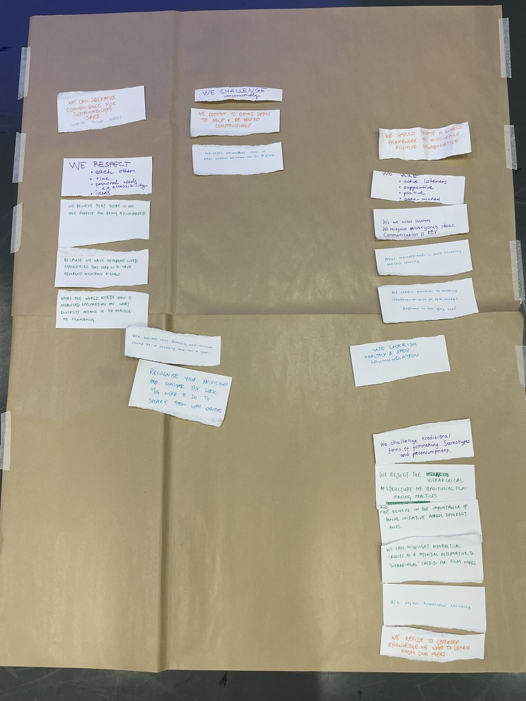
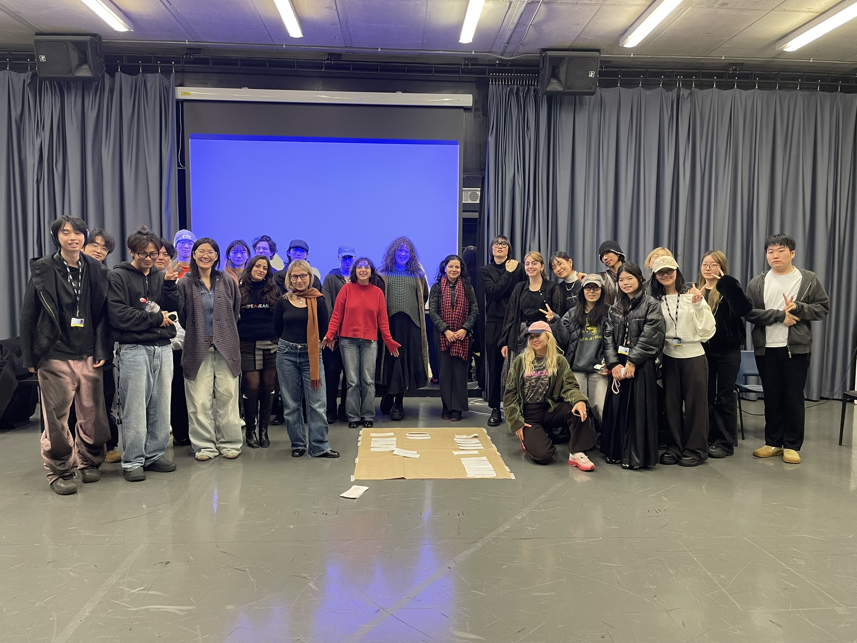
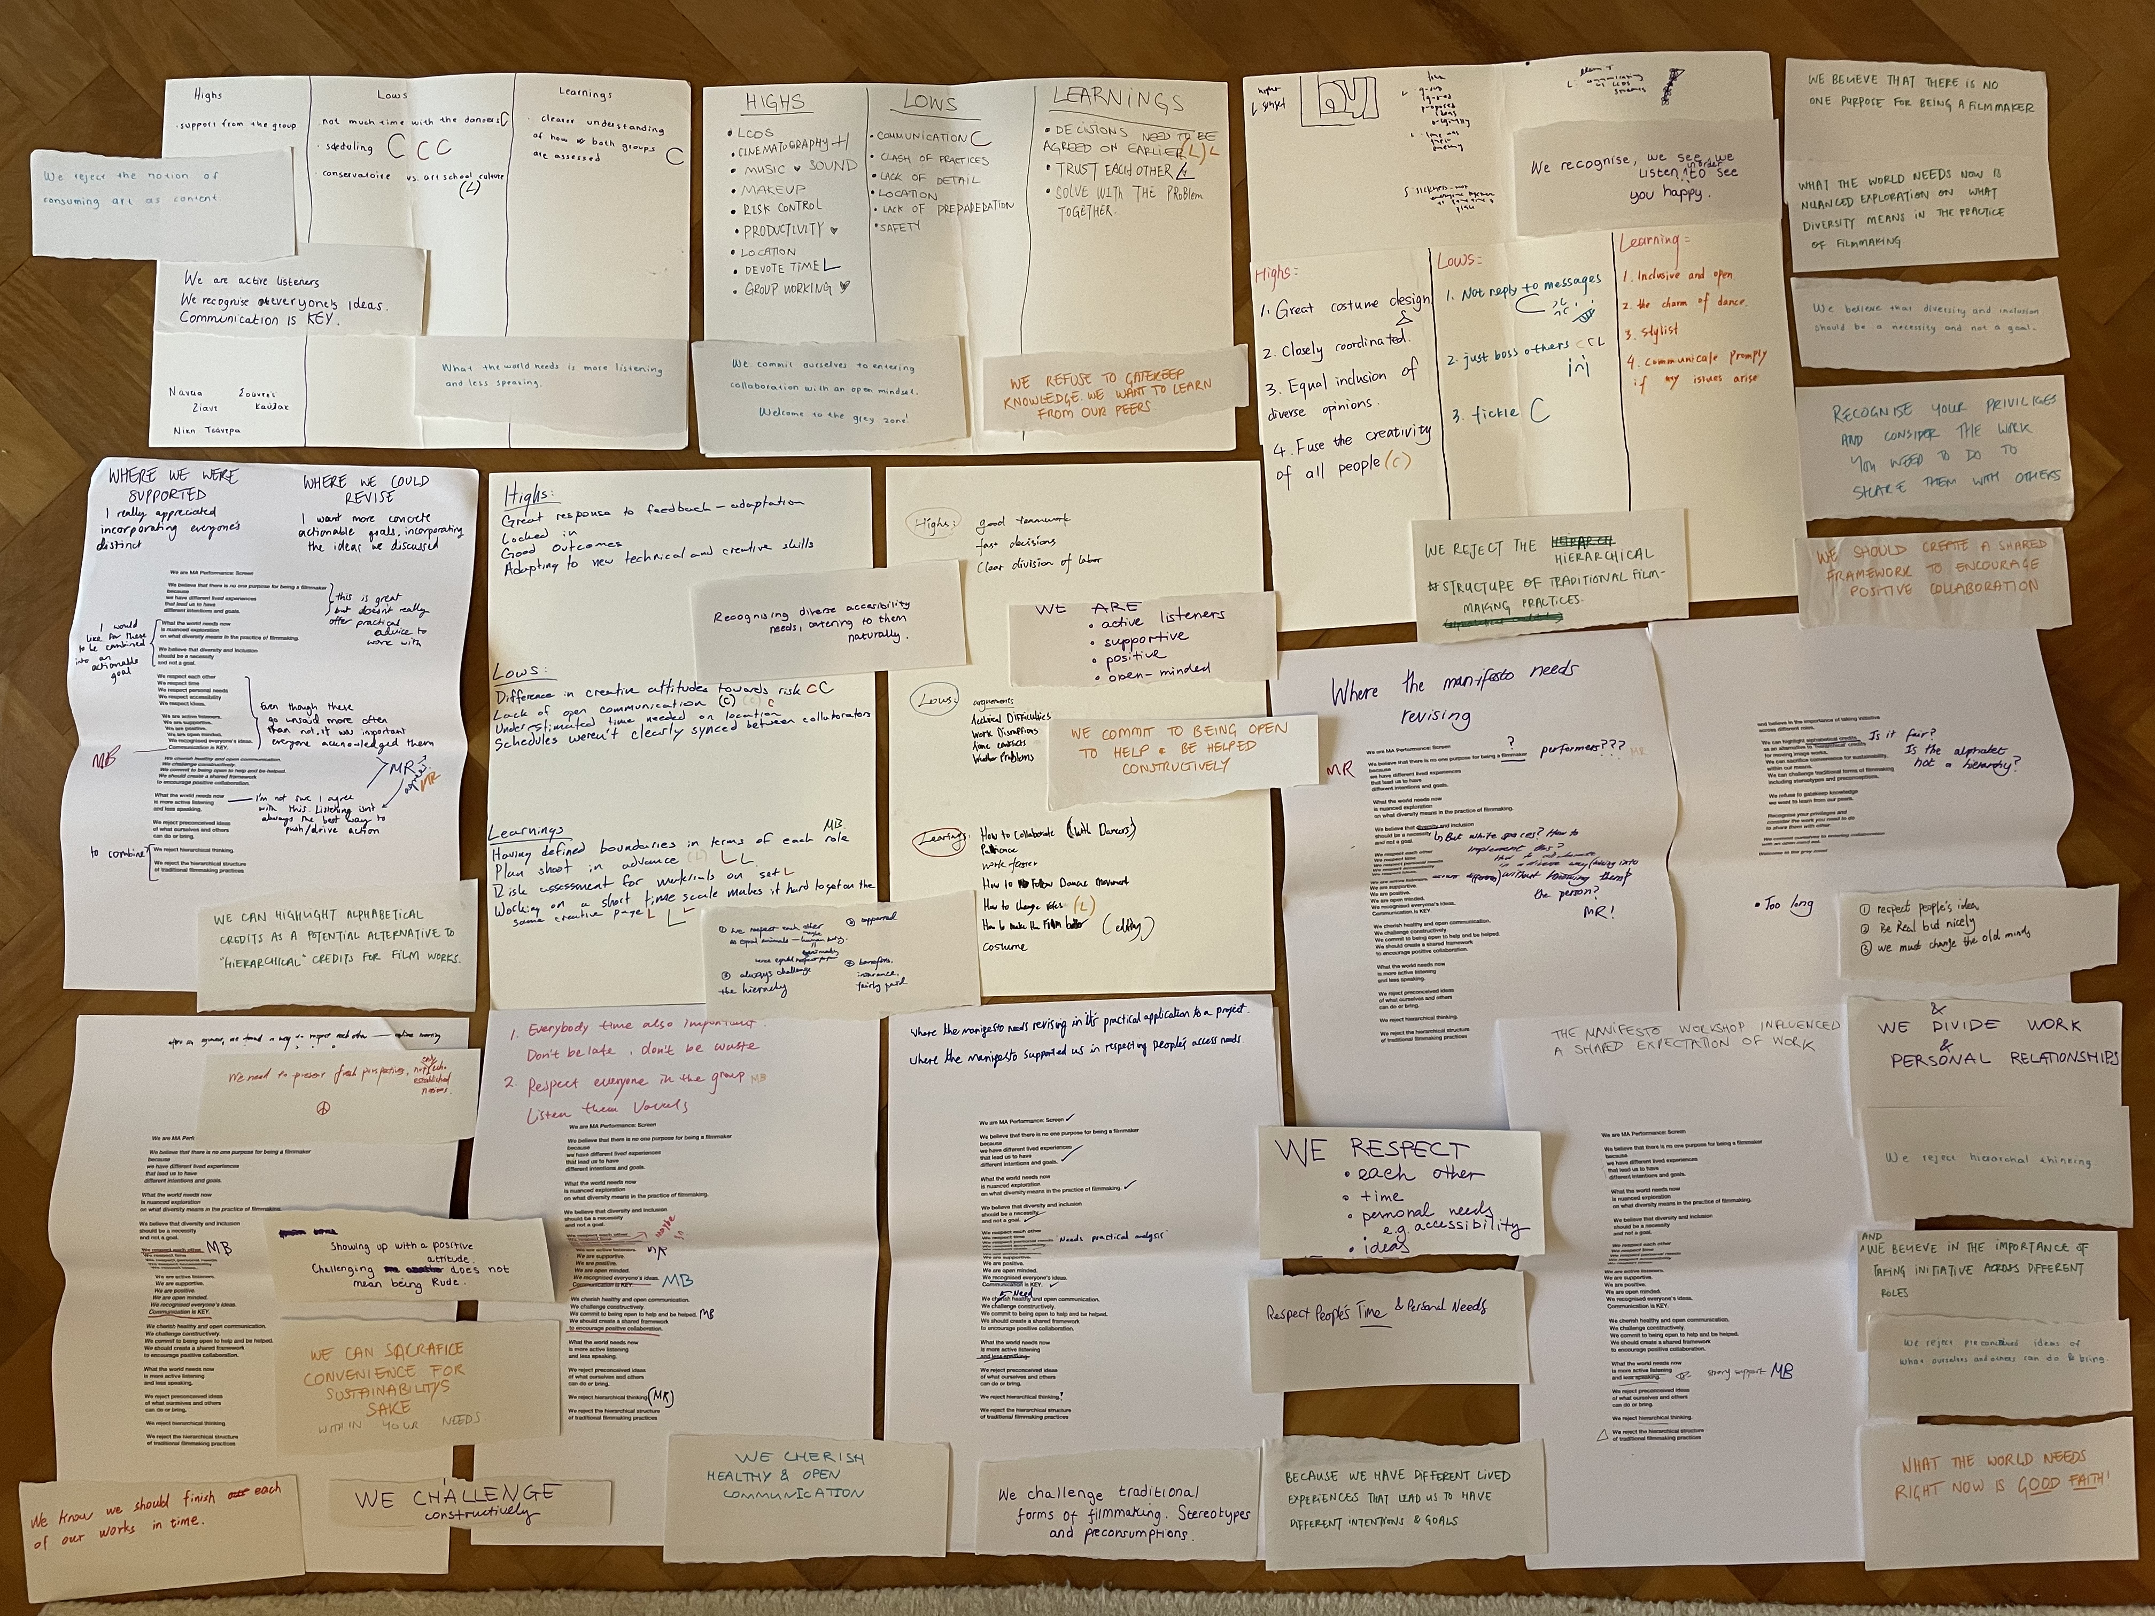
Research Process
Meeting with Course Leader 23rd September
Manifesto Workshop and Post Workshop Questionnaire Friday 14th November
LCDS collaboration Tuesday 17th November - 2nd December
Reflective Workshop and Manifesto Revision 2nd December

Slide 9
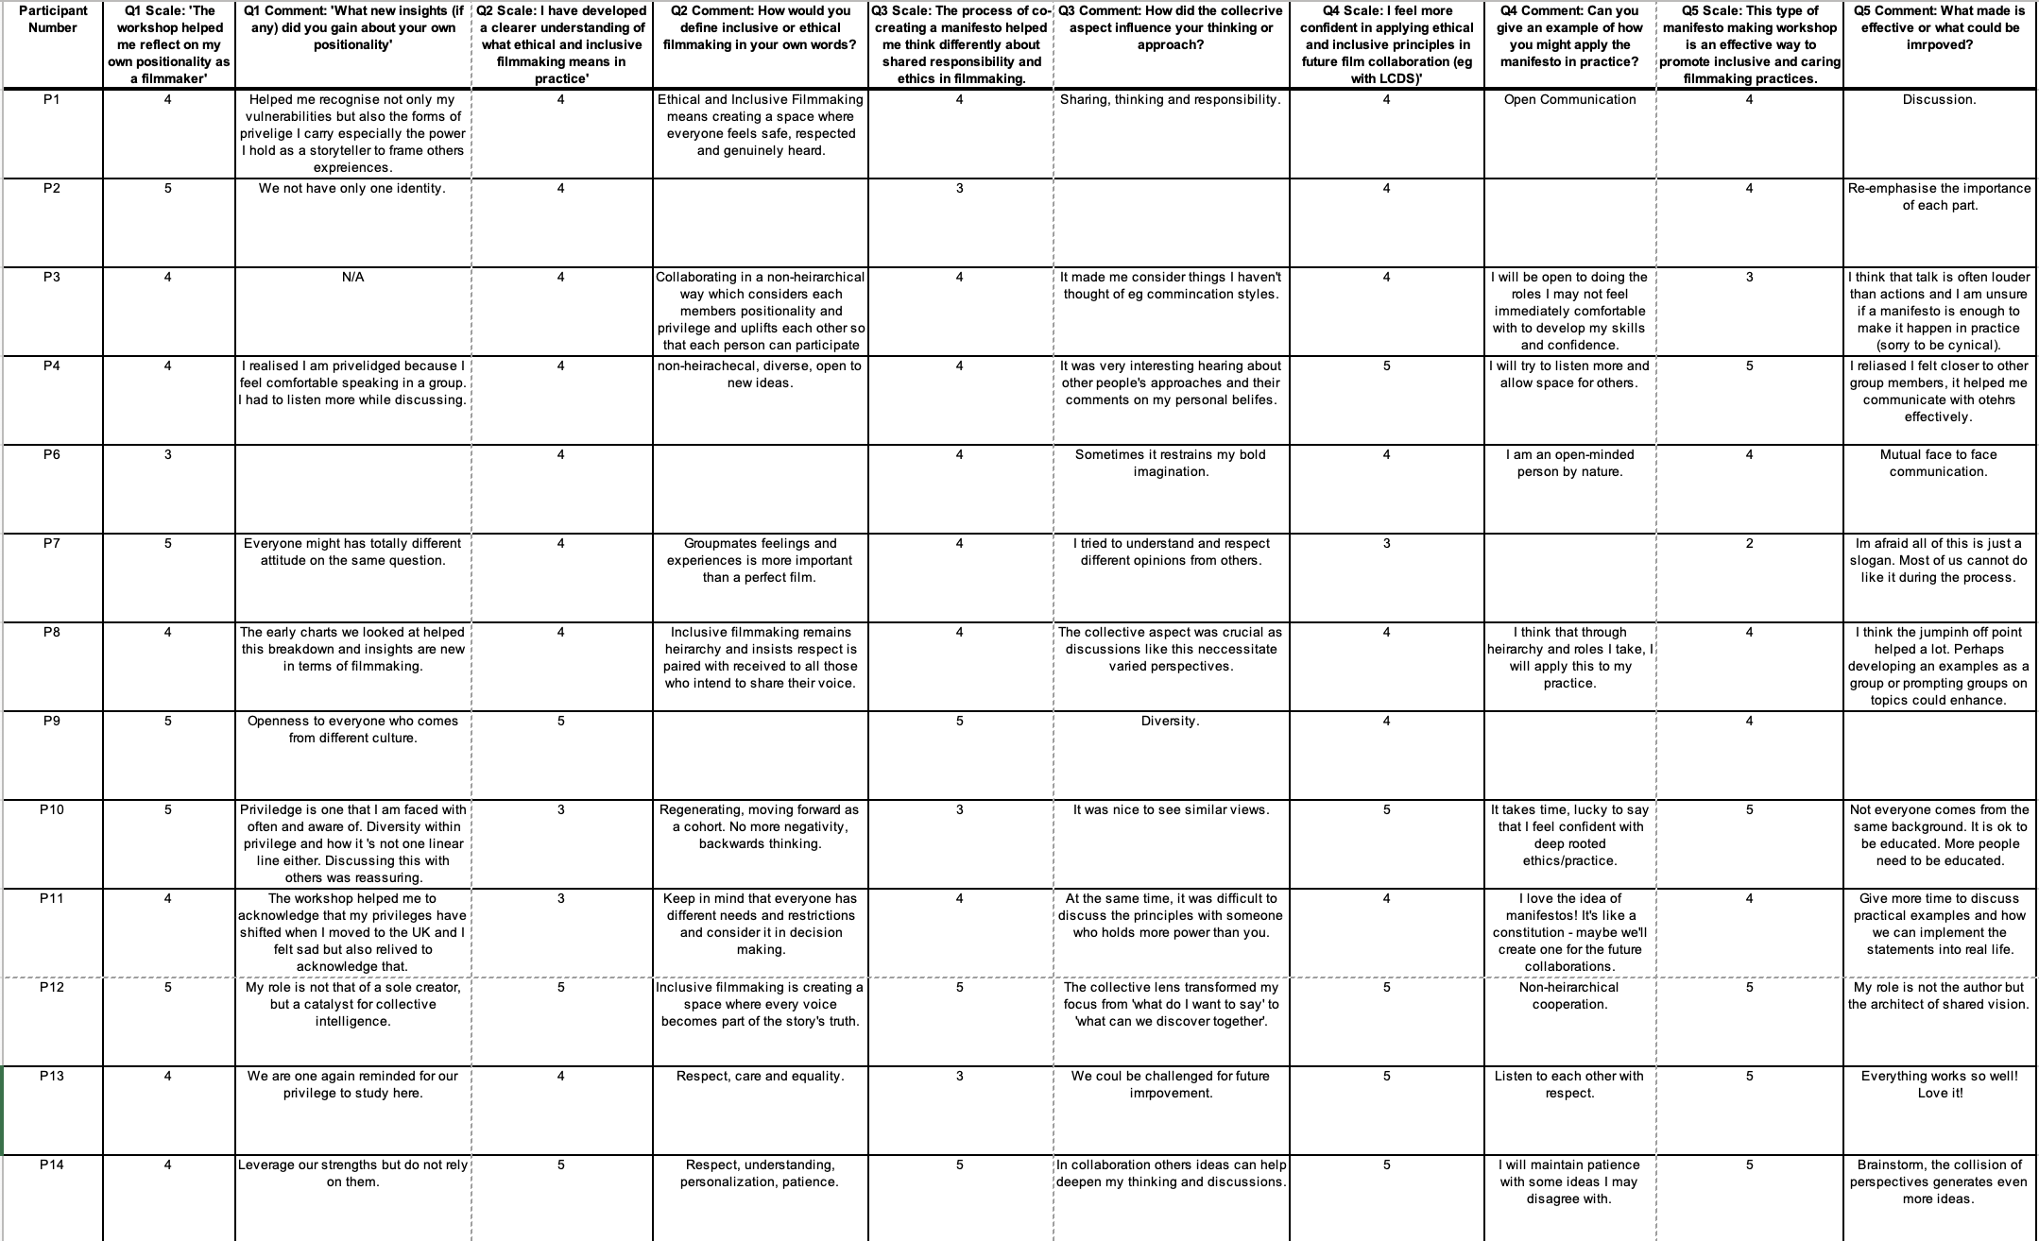
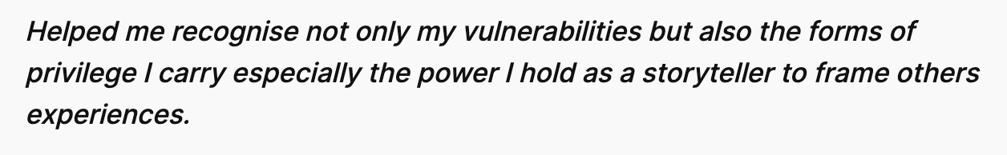
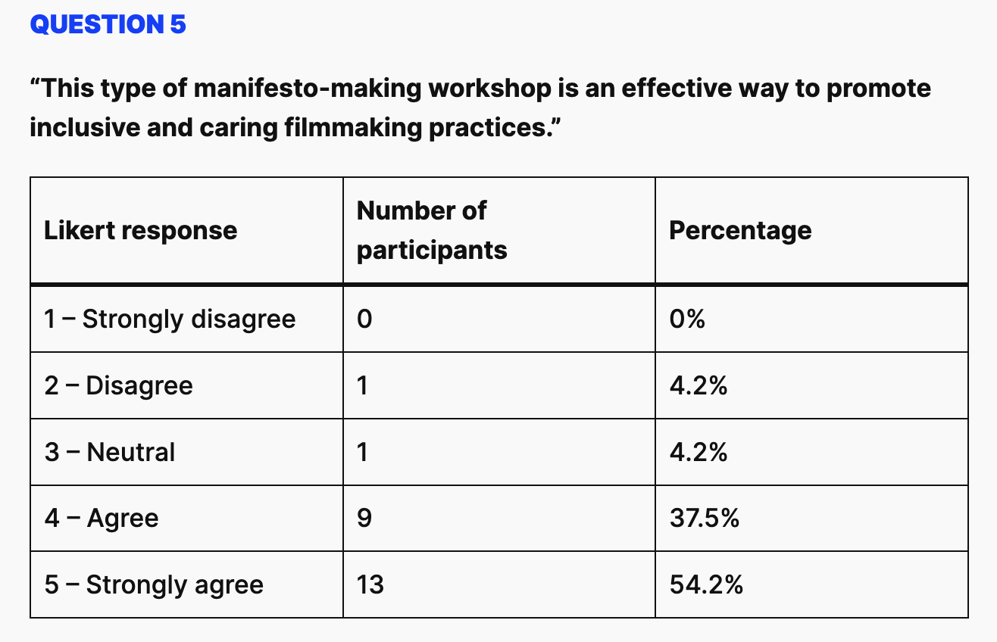
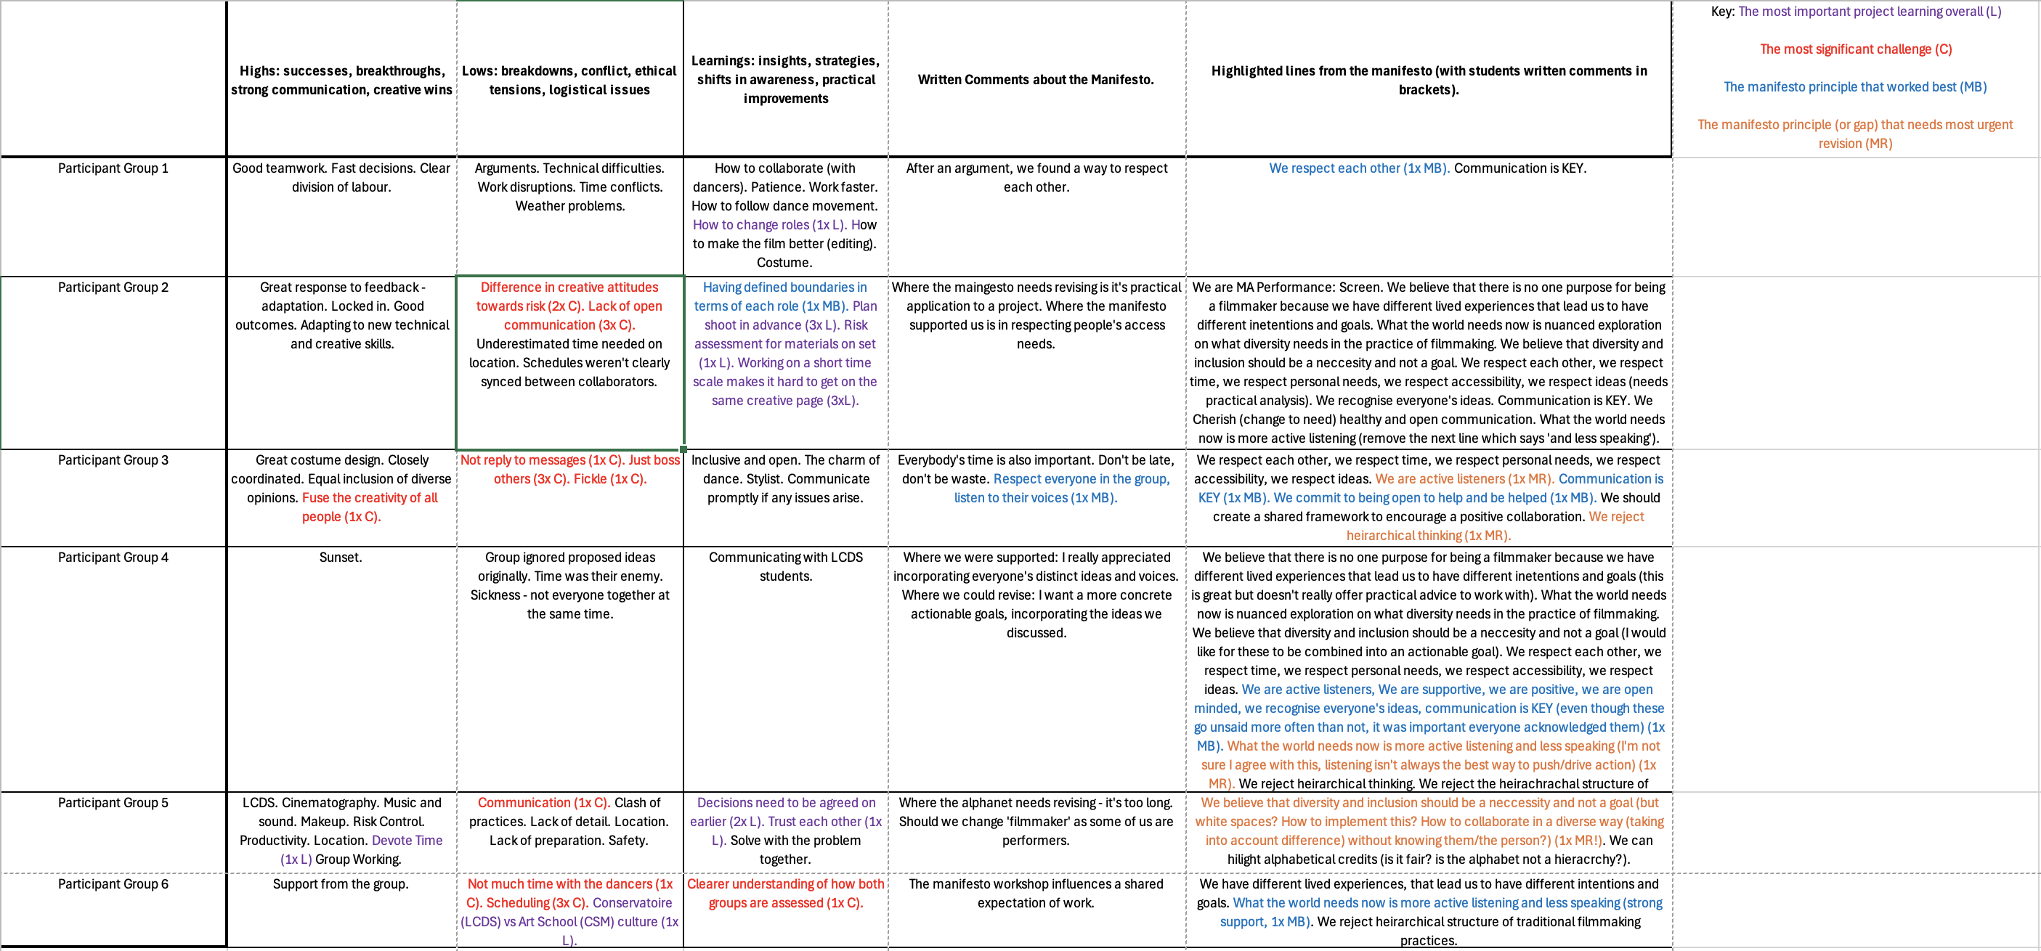
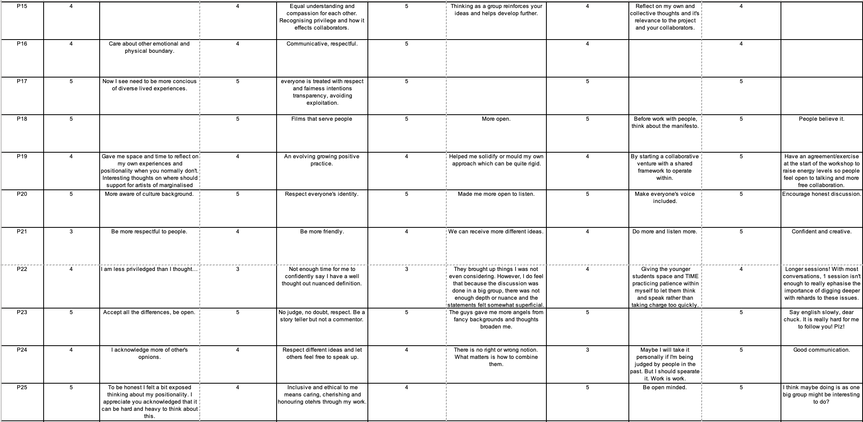


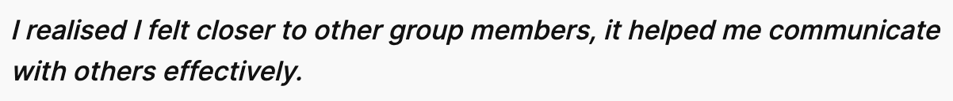
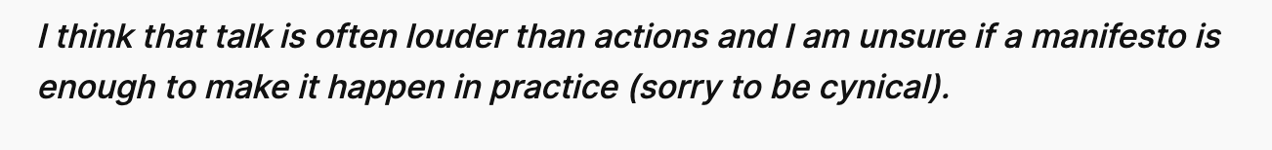
Research Process
Notes:
All of this generated a lot of data. I digitised all of it, which was very helpful for the Likert calculations but I actually found that spending time physically with the data, with the written quotes, feedback and manifesto, was the best way to immerse myself in the data and connect themes. It felt a lot like I was replicating the manifesto making process itself, cutting, sticking negotiating and editing. This also mirrors my filmmaking practice too.

Slide 10
Research Process
Collective manifesto-making workshop
→ articulated shared values
→ set a framework
Share findings and plan next stage
→ Understanding developed through
Iteration, not a single method.
Questionnaire (Likert + Reflections)
→ measured impact and surfaced tensions
Peer Analysis and collective
Group selections of data
→ mitigated researcher bias
Live collaborative project (LCDS)
→ tested ethics under pressure
→ complicated and deepened practice
Reflective Workshop
→ revised manifesto/values
→ shift from aspirational ethical positioning
to practice-based ethical understanding

Slide 11
Findings
Theme 1:
The Manifesto functions as a relational scaffold for collaboration
Theme 3:
Care, Support and Listening Were Central to the Experience
Theme 2:
Time Pressure Exposed Ethical Tensions and Structural Limitations
Theme 4:
The Manifesto Was Useful but Needs to Be More Actionable and Flexible
Theme 5:
Praxis is key to meaningful change
Notes:
The manifesto functioned as a relational scaffold that supported effective collaboration by reinforcing clear roles, open communication, mutual respect, and trusted decision-making across groups. Ethical practice was experienced as embedded in everyday working relationships, with trust emerging through shared action rather than remaining an abstract or aspirational value.
Time pressure exposed ethical tensions and structural limitations, with students experiencing conflict, fatigue, miscommunication, and creative compromise as care-led intentions collided with tight schedules and institutional demands. While the manifesto clearly articulated shared values, the findings show that ethical practice requires explicit support for decision-making, repair, and care under constraint, alongside course structures and timelines that enable those values to be enacted.
Care, support, and listening emerged as central to ethical collaboration, with students identifying moments of emotional attentiveness - particularly during uncertainty or difficulty - as key learning experiences. These findings show a shift from understanding care as an intention to recognising it as an active, practice-based responsibility that enables creative work and becomes most visible when things go wrong.
Students valued the manifesto but identified the need for it to be more actionable and flexible, particularly under pressure, with clearer guidance for conflict, accountability, and competing values. Rather than rejecting it, they engaged with the manifesto as a living document, demonstrating a practice-based shift from consuming ethical principles to actively revising and co-authoring them through experience.
The findings show that meaningful ethical understanding emerged through praxis, with many insights only becoming visible after the collaboration had concluded and students had space to reflect. The cycle of action, reflection, and revision—rather than the manifesto alone—enabled deeper learning, supporting the development of reflexive methodologies and a more sustainable ethical ecology within the cohort.

Slide 12
Revised Manifesto
WE ARE MA PERFORMANCE: SCREEN STUDENTS
We believe that there is no one purpose for being an artist
because
we have different lived experiences.
What the world needs now
is nuanced exploration of what diversity means
in the practice of filmmaking.
We believe that diversity and inclusion
should be a necessity
and not a goal.
We respect each other
We respect time
We respect personal needs
We respect accessibility
We respect ideas.
We are active listeners.
We are supportive.
We are positive.
We are open minded.
We recognise everyone’s ideas.
Communication is KEY.
We Value healthy and open communication.
We challenge constructively.
We commit to being open to help and be helped.
What the world needs now
is more active listening.
We challenge traditional forms of filmmaking
including stereotypes and preconceptions.
We reject preconceived ideas
of what ourselves and others
can do or bring.
We reject the hierarchical structure
of traditional filmmaking practices
and believe in the importance of taking initiative
across different roles.
We can sacrifice convenience for sustainability,
within our means.
We refuse to gatekeep knowledge
we want to learn from our peers.
Recognise your privileges and
consider the work you need to do
to share them with others.
We commit ourselves to entering collaboration
with an open mind set.
When challenges arise, we will return to this.

Slide 13
Next Steps
The manifesto will remain a live document
for the cohort throughout this year.
I plan to meet with the students again
at various points throughout the year.
The research has led to a revision of
the LCDS collaboration schedule.
I will explore the broader application
of a course wide manifesto.

Slide 14
Bibliography
Ahmed, S. (2012) On Being Included: Racism and Diversity in Institutional Life. Durham, NC: Duke University Press.
Arao, B. and Clemens, K. (2013) ‘From Safe Spaces to Brave Spaces: A New Way to Frame Dialogue Around Diversity and Social Justice’, in The Art of Effective Facilitation. 1st edn. New York: Routledge.
Converse, J.M. and Presser, S. (2011) ‘The Tools at Hand’, in Survey Questions: Handcrafting the Standardized Questionnaire. Thousand Oaks, CA: SAGE Publications.
Cook, T. (2009) ‘The purpose of mess in action research: building rigour through a messy turn’, Educational Action Research, 17(2), pp. 277–291.
Edstar Analytics (2022) Analyzing Likert Scale Data Using Excel: Computing Totals and Percentages (Intermediate) [Video]. YouTube. Available at: https://www.youtube.com/watch?v=bkYWyahlThQ&t=314s (Accessed: 10 December 2025).
Ellis, C.S. and Bochner, A.P. (2006) ‘Analyzing Analytic Autoethnography: An Autopsy’, Journal of Contemporary Ethnography, 35(4), pp. 429–449.
Freire, P. (1992) Pedagogy of Hope: Reliving Pedagogy of the Oppressed. New York: Continuum.
Helguera, P. (2011) Education for Socially Engaged Art: A Materials and Techniques Handbook. New York: Jorge Pinto Books.
hooks, b. (1994) Teaching to Transgress: Education as the Practice of Freedom. New York: Routledge.
Jokela, T. and Huhmarniemi, M. (2015) ‘Art-based action research in the development work of arts and art education’, Art, Design & Communication in Higher Education, 14(1), pp. 5–19.
Joshi, A., Kale, S., Chandel, S. and Pal, D.K. (2015) ‘Likert scale: explored and explained’, British Journal of Applied Science & Technology, 7(4), pp. 396–403. https://doi.org/10.9734/BJAST/2015/14975
Kemmis, S. and McTaggart, R. (2007) The Action Research Planner: Doing Critical Participatory Action Research. 3rd edn. Dordrecht: Springer.
Kimmerer, R.W. (2013) Braiding Sweetgrass: Indigenous Wisdom, Scientific Knowledge and the Teachings of Plants. Minneapolis, MN: Milkweed Editions.
Lenette, C. (2023) Participatory Action Research: Ethics and Decolonization. Oxford: Oxford University Press
McAteer, M. (2013) Action Research in Education. London: SAGE Publications. Available at: https://methods-sagepub-com.arts.idm.oclc.org/book/action-research-in-education (Accessed: [insert date]).
McIntyre, A. (2007) Participatory Action Research. Thousand Oaks, CA: SAGE Publications. Available at: https://dx.doi.org/10.4135/9781483385679
McNiff, J. (2002) Action Research for Professional Development: Concise Advice for New Action Researchers. 3rd edn. London: RoutledgeFalmer.
McTaggart, R., Nixon, R. and Kemmis, S. (2016) ‘Critical participatory action research’, in The Palgrave International Handbook of Action Research. New York: Palgrave Macmillan, pp. 21–35.
Mulvey, L. (1975) ‘Visual Pleasure and Narrative Cinema’, Screen.
Murch, W. (2001) In the Blink of an Eye: A Perspective on Film Editing. 2nd edn. Los Angeles, CA: Silman-James Press.
Okolie (2023) Likert Scale Data Analysis and Interpretation of Results [Video]. YouTube, 14 July. Available at: https://www.youtube.com/watch?v=uHteOFO84MM (Accessed: 10 December 2025).
Renov, M. (2004) The Subject of Documentary. Minneapolis, MN: University of Minnesota Press.
Rosenberg, M. (2015) How to Express Needs | Nonviolent Communication Explained [Video]. YouTube. Available at: https://www.youtube.com/watch?v=3l8l4prc-_Q (Accessed: 12 October 2025).
Stelson, E.A., Bolenbaugh, M., Woods-Jaeger, B., Branch, C. and Ramirez, M. (2021) ‘Identifying research participation effects through qualitative methods: Feedback from Research Engagement Consultants involved in a pediatric mental health comparative effectiveness trial’, SSM – Qualitative Research in Health.
Willis, J. and Edwards, C. (2014) Action Research: Models, Methods, and Examples. Charlotte, NC: Information Age Publishing.
Wolgemuth, J.R., Guyotte, K.W. and Shelton, S.A. (eds.) (2024) Expanding Approaches to Thematic Analysis: Creative Engagements with Qualitative Data. London: Taylor & Francis.

