Slide 1
Manifesting Change:
Co-creating Ethical Approaches to Filmmaking Practices
This workshop has been developed as part of an action research project exploring how to encourage inclusive filmmaking practices in higher education.
Together we will:
Reflect on positionality and ethical responsibilities in collaborative filmmaking.
Explore the use of manifestos as both creative declaration and ethical contract.
Use manifesto making as a creative process to articulate collective commitments to inclusion, care and accountability.
Produce a shared manifesto that can guide future collaborations with external partners (eg LCDS).
Please remember: this is a space of respect, curiosity, listening to understand, assuming positive intent and being kind with one another.
Notes:
2pm

Slide 2
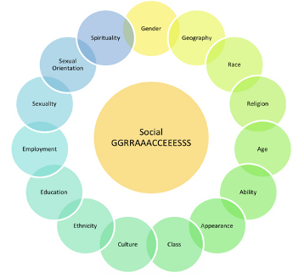
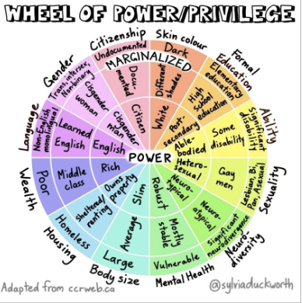
Positionality/Intersectionality
Take 5 minutes to ‘free write’ a response to the following prompts:
What values guide my collaborative filmmaking practice?
How might my identity shape how I work with others?
When have I felt included on excluded in creative collaboration?
You will then share some reflections from your writing with a partner. Please only share what you feel comfortable discussing.
Notes:
Sylvia Duckworth’s ‘Wheel of Power and Privilege’ – a reflective tool to map how different attributes (such as race, gender, ability, class) intersect. It works well alongside frameworks like the Social GRACES to provide a fuller picture of identity and proximity to power. Elements of these wheels are arguably reductive, and many are in flux. However, they are a useful strating point for considering our own proximity to power.

Slide 3
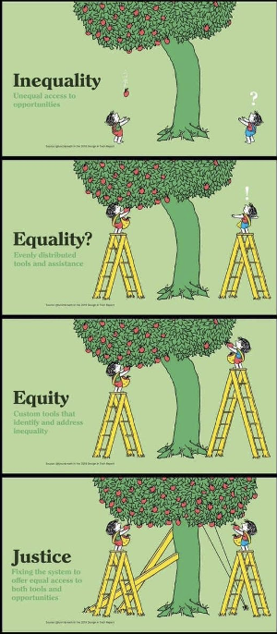
Resistance to stepping out of our comfort zones upholds exclusion.
“I can 100 percent promise that you learning sign language is easier than a deaf person learning to hear.”
Christine Sun Kim referencing Sara Nović.
Sara Ahmed (2012) describes how institutional spaces are built for certain bodies to move comfortably, while others are forced to navigate around “brick walls.”
Notes:
Sylvia Duckworth’s ‘Wheel of Power and Privilege’ – a reflective tool to map how different attributes (such as race, gender, ability, class) intersect. It works well alongside frameworks like the Social GRACES to provide a fuller picture of identity and proximity to power. Elements of these wheels are arguably reductive, and many are in flux. However, they are a useful strating point for considering our own proximity to power.

Slide 4
Grounding Exercise
Take 5 minutes to ‘free write’ a response to the following prompts:
What values guide my collaborative filmmaking practice?
How might my identity shape how I work with others?
When have I felt included on excluded in creative collaboration?
You will then share some reflections from your writing with a partner. Please only share what you feel comfortable discussing.
Notes:
2pm

Slide 5
Why Manifestos?
A manifesto is a document that acts as a public declaration of the intentions, motives or views of its issuer. While it can address any topic it often concerns art, literature or politics.
Manifestos are often written in the name of a group sharing a common perspective, ideology or purpose.
Notes:
2pm

Slide 6
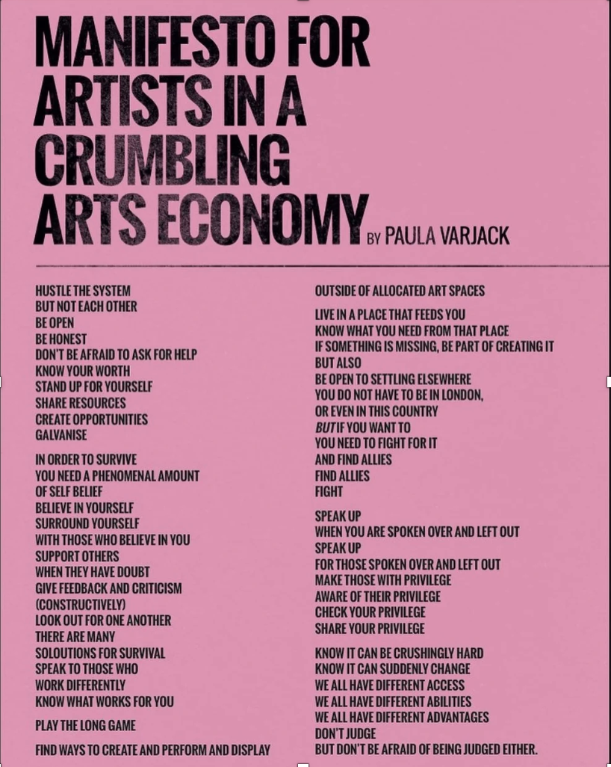
Manifesto Examples
Notes:
2pm

Slide 7
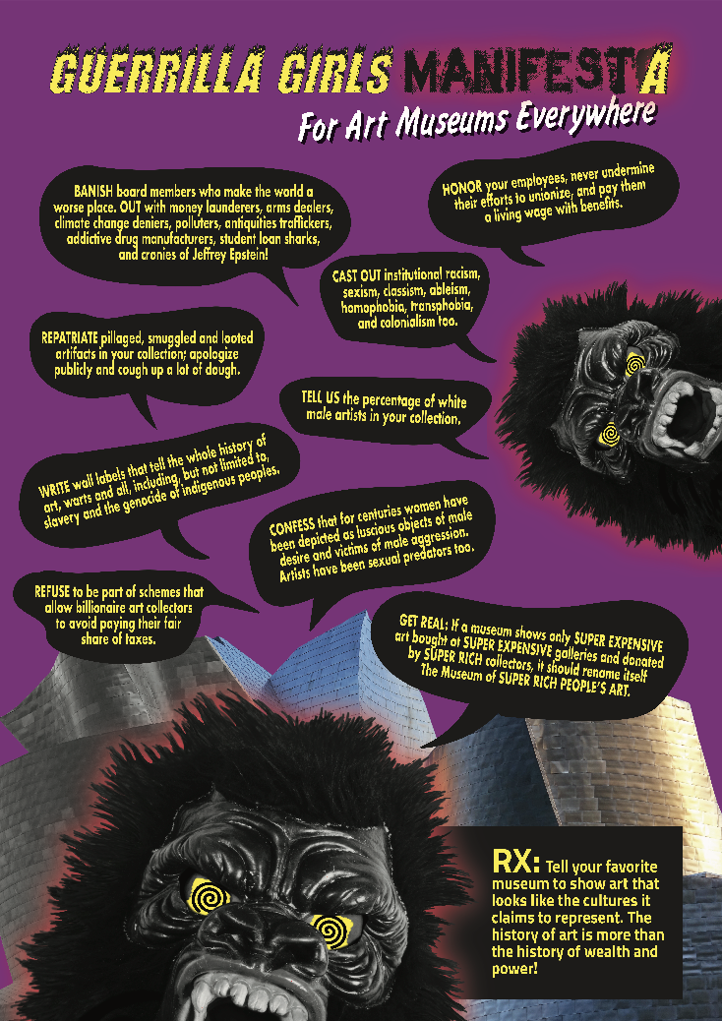
Manifesto Examples
Notes:
Guerrilla Girls is an anonymous group of feminist artists on a longstanding mission to fight sexism and racism within the art world. The group was formed in New York City in 1985 to tackle systemic issues with guerrilla methods, using iconic posters, books, billboards, interviews and more. Their work is colorful, distinctive and humorous. To protect individual identities in interviews, they wear gorilla masks and use pseudonyms that refer to historical female artists such as Frida Kahlo and Käthe Kollwitz, as well as writers and activists like Gertrude Stein and Harriet Tubman.

Slide 8
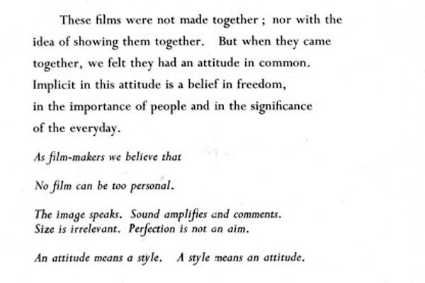
The Free Cinema Manifesto 1956
Notes:
The Free Cinema Manifesto was a declaration of principles for the Free Cinema movement, a 1950s British documentary film movement co-written by Lindsay Anderson and Lorenza Mazzetti. It emphasized a new approach to filmmaking with an "attitude" rooted in freedom, the significance of ordinary life, and a DIY aesthetic, rejecting the established norms of both Hollywood and traditional documentary styles.

Slide 9
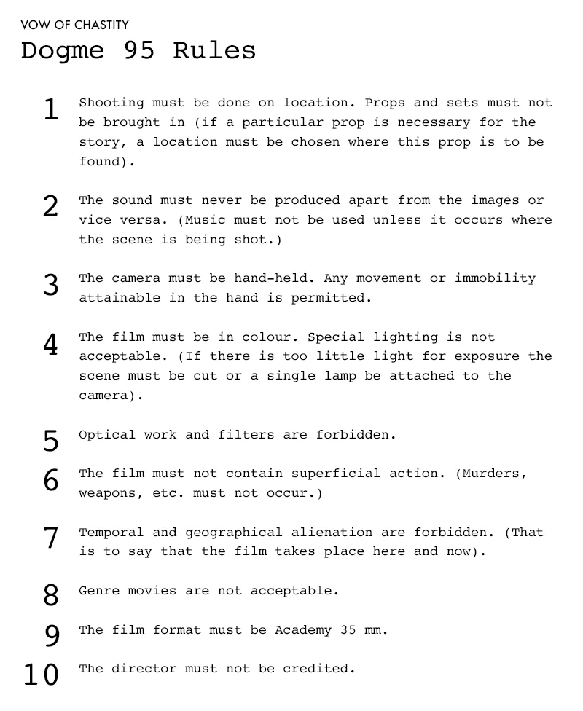
Manifesto Examples
Notes:
The Dogme 95 manifesto, a set of 10 rules known as the "Vow of Chastity," was created by Lars von Trier and Thomas Vinterberg to strip away cinematic artifice and return to filmmaking's core elements.

Slide 10
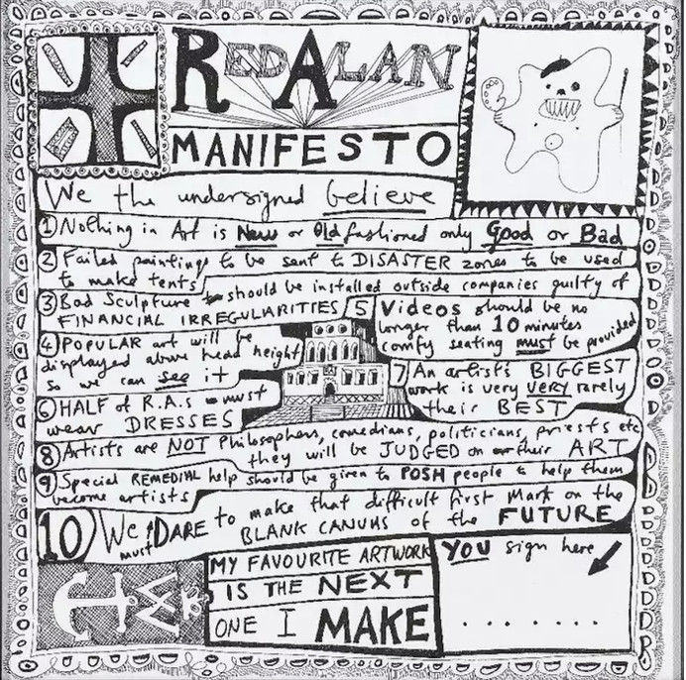
Red Alan Manifesto
by Grayson Perry
Notes:
n his series of Reith Lectures last year, Grayson Perry RA provided a thoughtful, witty and provocative take on many of the art world's most debated questions. Can anything be art? Who decides whether art is good or bad? Does democracy have bad taste?
Continuing in this theme, Perry has created a special manifesto for the Royal Academy of Arts under the authorship of Red Alan (pictured above), a ceramic sculpture of his famed childhood teddy bear, Alan Measles.

Slide 11
Collective Co-Creation: Writing the Manifesto
In small groups of 4/5, use pens and individual strips of paper to create a series of statements for our manifesto (one statement per paper). Use the prompts below to help shape them:
1) What commitments do we want to make as ethical, inclusive filmmakers?
2) How do we want others to feel when they collaborate with us?
3) What must we challenge? What must we change?
4) What does care look like in our filmmaking?
You can also use the following sentence starters:
We are…
We believe…
We reject…
We refuse to…
Because…
We can…
We feel…
We know…
What the world needs now is…
We are
Notes:
Whose voices are missing from this? How might this read to a collaborator from outside our institution?

Slide 12
Collective Editing
We will now merge our group work into one shared manifesto.
Each group will present their section and selects a couple of lines that they definitely want included, these are moved to the large floor document.
As a group, we will then edit and refine by combining overlapping ideas and checking what’s missing.
We will then decide on a collective sign off.
Notes:
Whose voices are missing from this? How might this read to a collaborator from outside our institution?

Slide 13
Reflection/Check Out
Share back ‘one word I’m taking away’
The manifesto will now be typed up and printed. I will share with you soon.
There will be a follow up session in December following the collaboration to reflect on this process.
Those who are happy to participate in the research, please complete the form.
Notes:
Whose voices are missing from this? How might this read to a collaborator from outside our institution?

